Slide 1
For presentation

Slide 2
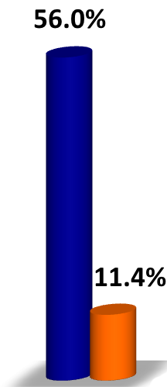
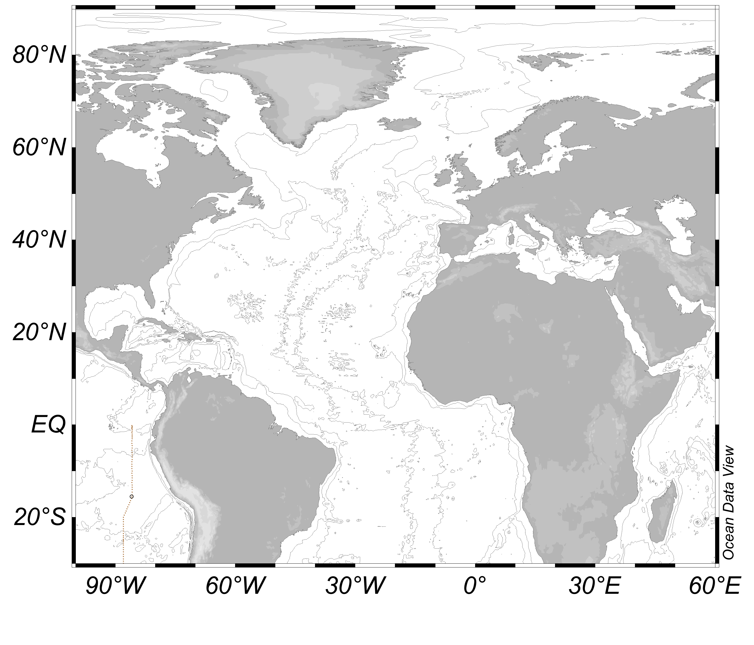
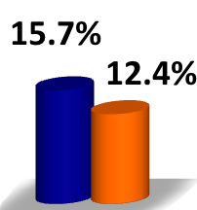
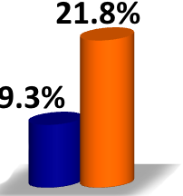
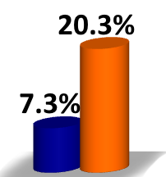
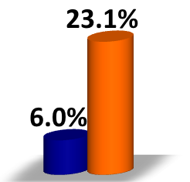
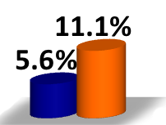


TRC25
TRC26
TRC19
TRC20
Other Ocean
TRC14
Composition of watermass (0-800 m)

Slide 3
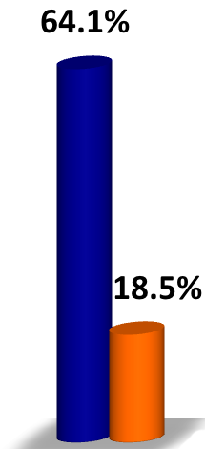
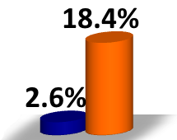
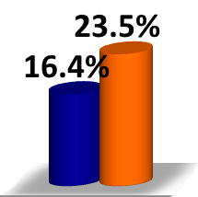
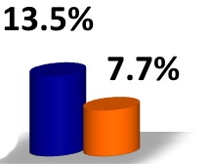
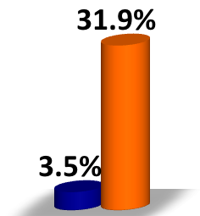
TRC29
TRC27
TRC25
TRC26
Other Ocean
Composition of watermass (2500 m)

Slide 4
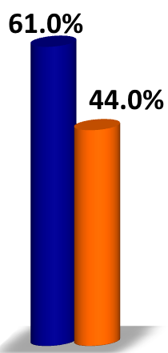
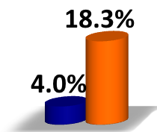
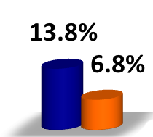
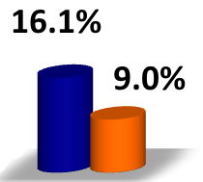
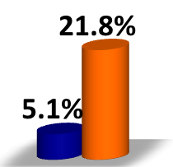
TRC28
TRC27
TRC25
TRC26
Other Ocean
Composition of watermass (4500 m)

Slide 5
For publication

Slide 6
(a)
TRC25
TRC26
TRC19
TRC20
Other Ocean
TRC14
Notes:
Composition of watermass (0-800 m)

Slide 7
(b)
TRC29
TRC27
TRC25
TRC26
Other Ocean
Notes:
Composition of watermass (2500 m)

Slide 8
(c)
TRC28
TRC27
TRC25
TRC26
Other Ocean
Notes:
Composition of watermass (4500 m)

